Slide 1

BUSINESS,
PEACE & MINING SECTOR IN AFRICA

Slide 2
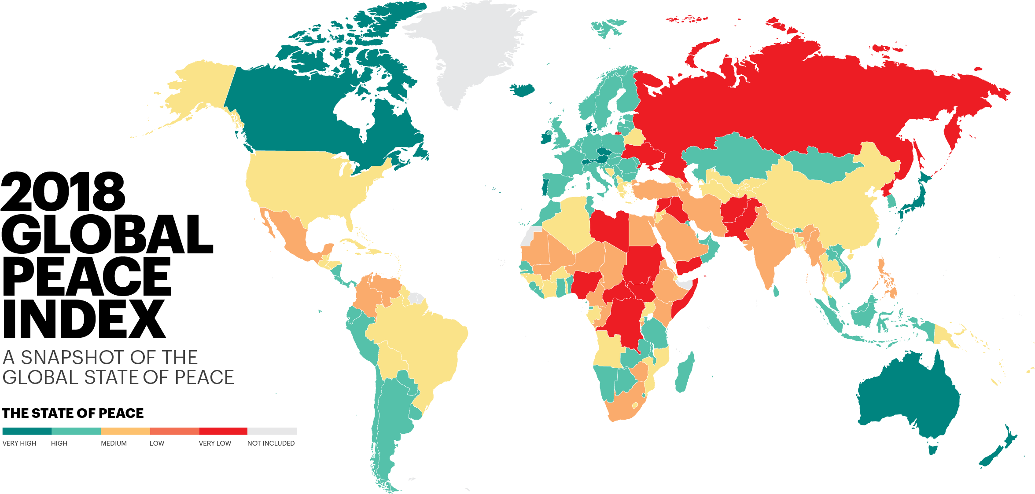

Slide 3
GLOBAL ECONOMIC IMPACT OF VIOLENCE WAS $14.76 TRILLION (PPP) IN 2017.
EQUIVALENT TO 12.4% GLOBAL GDP

Slide 4
TODAY’S AGENDA
Business is good for peace, peace is good for business
Investing in Peace
  Spotlight on Africa
Positive Peace as Peacebuilding Framework
Activating Positive Peace

Slide 5

BUSINESS IS GOOD FOR PEACE, PEACE IS GOOD FOR BUSINESS

Slide 6


PEACE AND ECONOMIC PERFORMANCE
Countries with very high level of peace achieved over 3 times higher GDP compared to the least peaceful countries for the last 20 years.
Countries with highest improvements in peacefulness over the last decade recorded GDP per capita growth 7 times higher than those that deteriorated most.
Low peace countries economies’ are more volatile

Slide 7
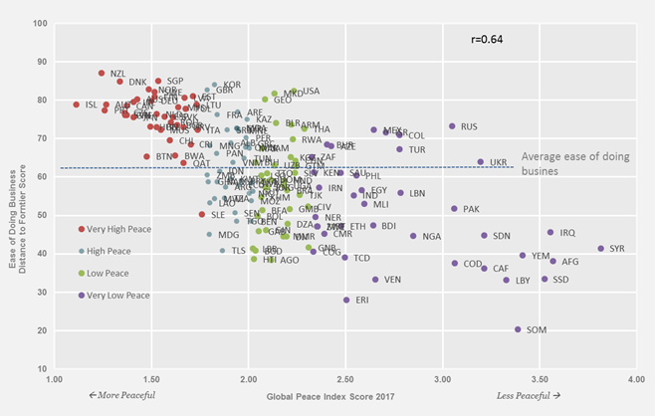
PEACEFULNESS AND EASE OF DOING BUSINESS

Slide 8
PEACE AND ECONOMICS FEED-BACK LOOP
Upward Spiral
Heightened levels of economic activity
  increases degree of interdependence between individuals and groups
  Incentive for maintaining and upholding Peace grows stronger as degree of economic inter-dependence rises
Downward Spiral
At low levels of economic activity
  unemployed agents may disrupt economic activities through violent means
  Cost of doing business increases, profitability decreases, potential future investment of businesses declines

Slide 9
MOST SERIOUS CONSTRAINT TO BUSINESS BY PEACEFULNESS

Slide 10
INVESTING IN PEACE

Slide 11
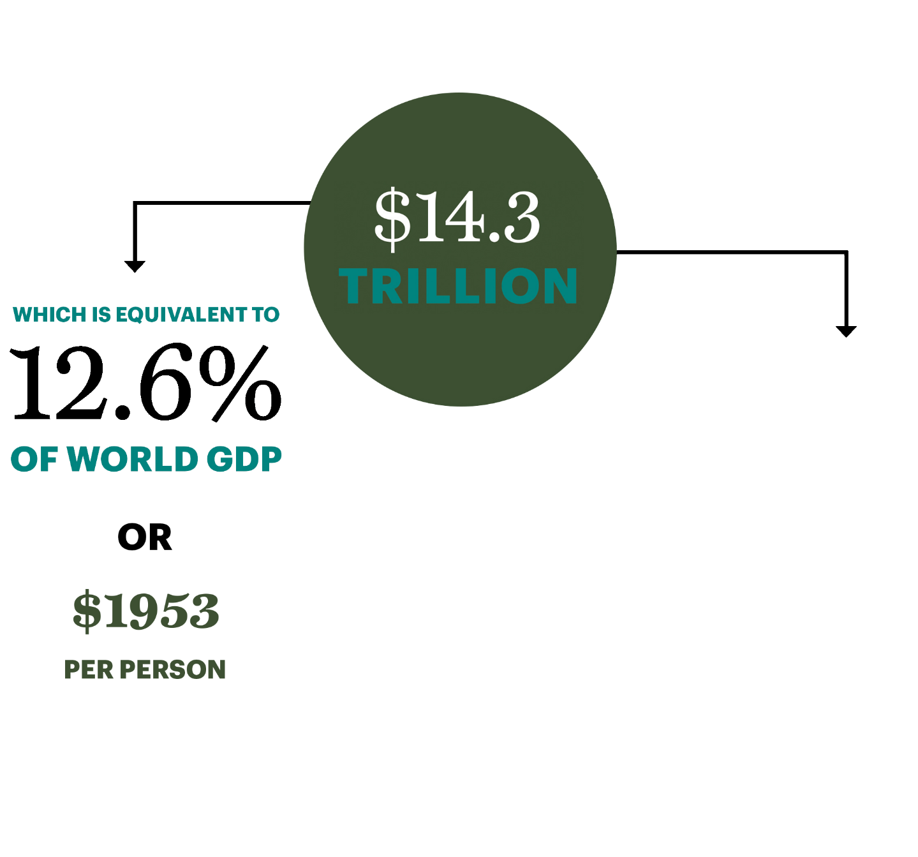
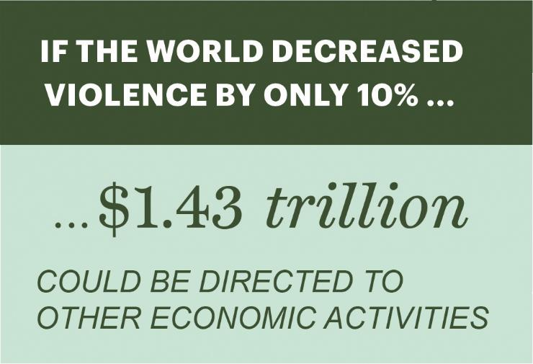
THE GLOBAL COST OF VIOLENCE, 2017
163
8
4
8
$1988

Slide 12
GLOBAL ECONOMIC IMPACT OF VIOLENCE
The average economic cost of violence was equivalent to 45 per cent of GDP in the ten countries most impacted by violence, compared to only two per cent in the ten least affected.
In the last 70 years, per capita GDP growth has been three times higher in highly peaceful countries compared to those with low levels of peace.
The global economy would be US$13.87 trillion larger than its current level if low peace countries achieved GDP growth equivalent to highly peaceful countries.

Slide 13
GLOBAL ECONOMIC IMPACT OF VIOLENCE

Slide 14
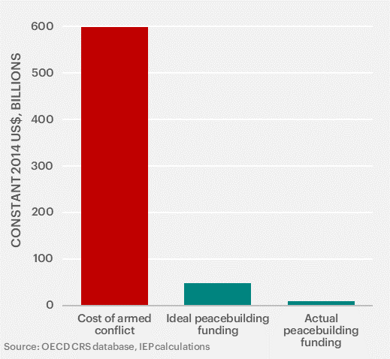
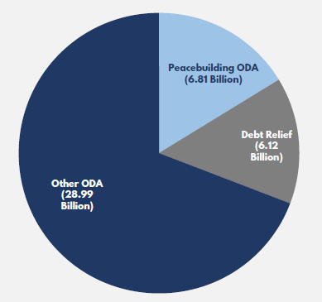
CONFLICT COSTS FAR EXCEED PEACEBUILDING
Peacebuilding is 16% of total ODA in fragile countries

Slide 15
THE ESTIMATED COST-BENEFIT RATIO OF PEACEBUILDING INTERVENTIONS IS 1:16.
163
1:16
If the activities in 50% of the countries at risk were successful the ROI would be 4:1.
Even in countries which aren’t at risk, the activities would build stronger institutions and states.

Slide 16
POSITIVE PEACE AS PEACEBUILDING FRAMEWORK

Slide 17
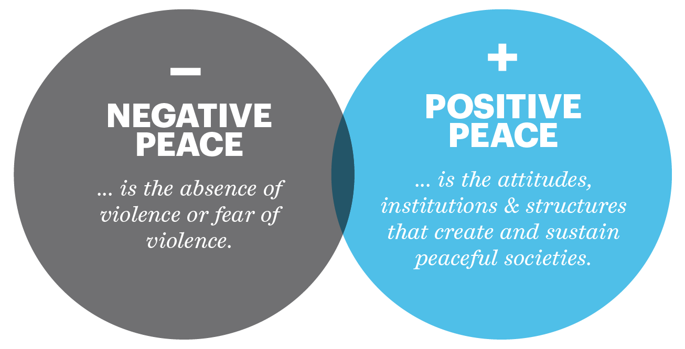
WHAT IS POSITIVE PEACE?

Slide 18
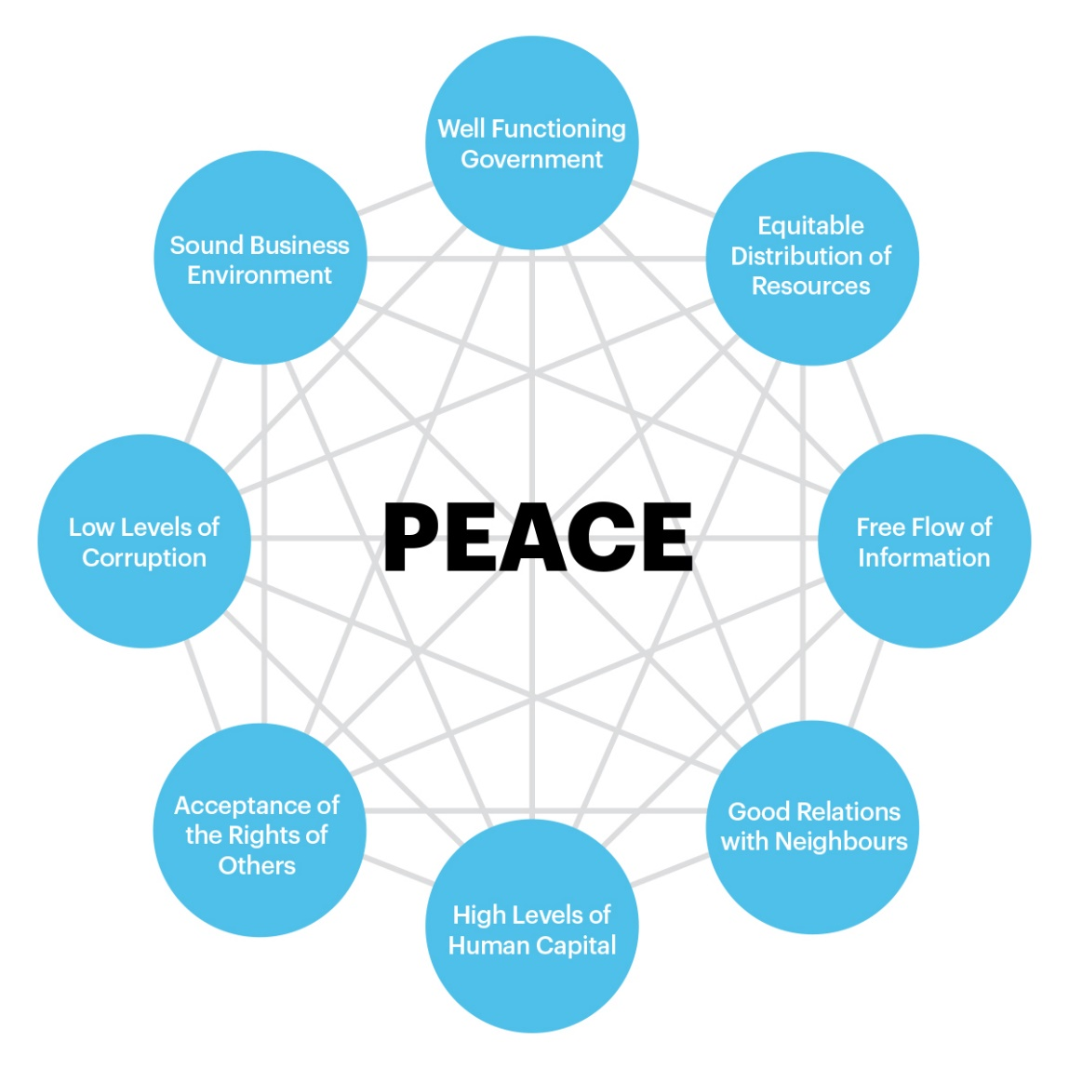
Positive Peace
163
Notes:
Our positive peace framework is built in eight pillars all of which are interlinked.
• Well-functioning Government – A well-functioning government delivers high-quality public and civil services, engenders trust and participation, demonstrates political stability and upholds the rule of law.
• Sound Business Environment – The strength of economic conditions as well as the formal institutions that support the operation of the private sector. Business competitiveness and economic productivity are both associated with the most peaceful countries.
• Equitable Distribution of Resources – Peaceful countries tend to ensure equity in access to resources such as education, health and, to a lesser extent, equity in income distribution.
• Acceptance of the Rights of Others – Peaceful countries often have formal laws that guarantee basic human rights and freedoms and the informal social and cultural norms that relate to behaviours of citizens.
• Good Relations with Neighbours – Peaceful relations with other countries are as important as good relations between groups within a country. Countries with positive external relations are more peaceful and tend to be more politically stable, have better functioning governments, are regionally integrated and have lower levels of organised internal conflict.
• Free Flow of Information – Free and independent media disseminates information in a way that leads to greater knowledge and helps individuals, business and civil society make better decisions. This leads to better outcomes and more rational responses in times of crisis.
• High Levels of Human Capital – A skilled human capital base reflects the extent to which societies educate citizens and promote the development of knowledge, thereby improving economic productivity, care for the young, political participation and social capital.
• Low Levels of Corruption - In societies with high levels of corruption, resources are inefficiently allocated, often leading to a lack of funding for essential services and civil unrest. Low corruption can enhance confidence and trust in institutions.

Slide 19
CHARACTERISTICS OF POSITIVE PEACE
163
SYSTEMIC AND COMPLEX
VIRTUOUS OR VICIOUS
PREVENTATIVE
UNDERPINS RESILIENCE AND NON-VIOLENCE
INFORMAL AND FORMAL
SUPPORTS DEVELOPMENT GOALS

Slide 20
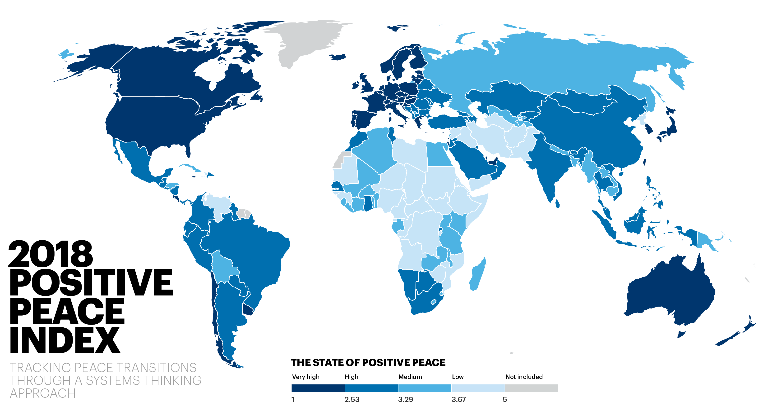

Slide 21
HIGHER LEVELS OF POSITIVE PEACE ARE ASSOCIATED WITH –
Higher per capita income
Resilience in the face of shocks
Better environmental outcomes
Better performance on SDGs

Slide 22
POSITIVE PEACE – PREDICTING ECONOMIC PERFORMANCE
Countries that improve in Positive Peace since 1996 have 2% higher GDP growth than countries that deteriorate in Positive Peace
Every 1% improvement in Positive Peace is associated with 2.9% per cent growth in real GDP per capita from 2005 to 2016.

Slide 23
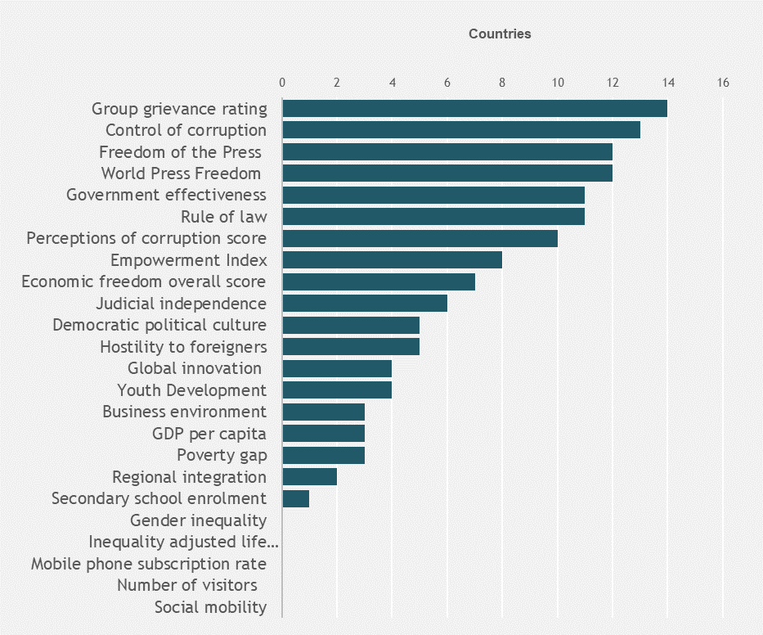
FALLS IN POSITIVE PEACE PRECEDE VIOLENCE
Deteriorations in Group Grievances, Control of Corruption and Freedom of the Press are common leading indicators of conflict onset.
163

Slide 24
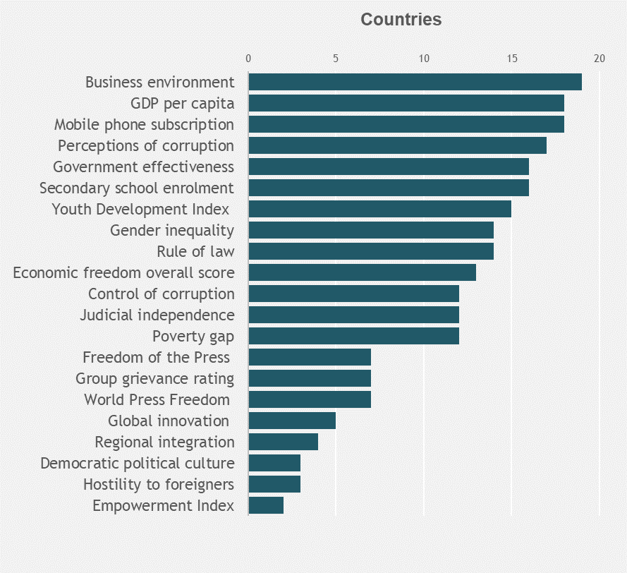
GAINS IN POSITIVE PEACE PRECEDE GAINS IN PEACE
Improvements in Business Environment, GDP, Mobile Phones are common leading indicators of improvements in peace.
163

Slide 25
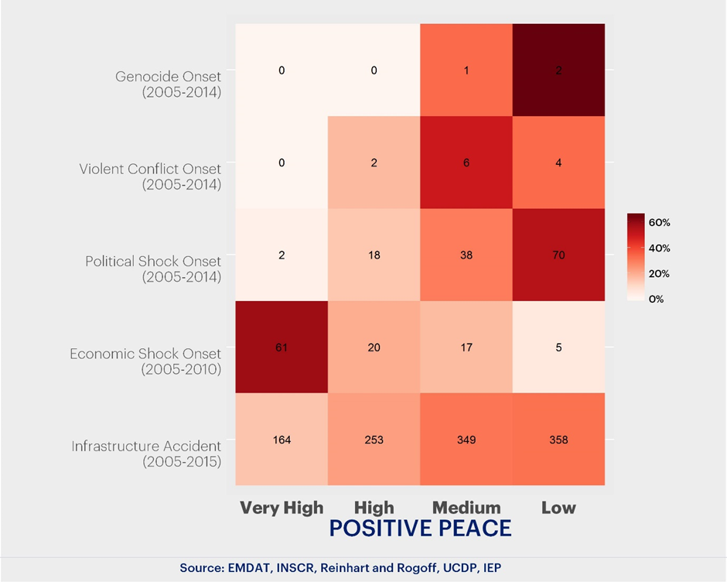
POSITIVE PEACE AND INTERNAL SHOCKS
.
INCIDENCE OF SHOCKS BY LEVELS OF POSITIVE PEACE
163
2
6
70
61

Slide 26
PREVELANCE AND NATURE OF RESISTANCE CAMPAIGNS
163
Source: University of Denver, IEP Calculations

Slide 27
SPOTLIGHT ON AFRICA

Slide 28
ECONOMIC IMPACT OF VIOLENCE AFRICA
163
$616 BILLION
TOTAL ECONOMIC IMPACT OF VIOLENCE, 2017
21% INCREASE IN IMPACT
SINCE 2007

Slide 29
ECONOMIC IMPACT OF VIOLENCE AFRICA
163

Slide 30
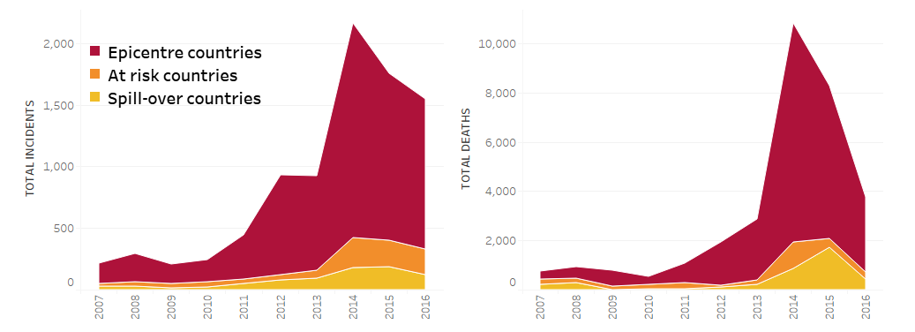
IMPACT OF TERRORISM IN AFRICA

Slide 31
ECONOMIC IMPACT OF TERRORISM IN AFRICA
$119 BILLION
Total cost 2007-2016
10 X INCREASE IN COST
In 2007, $1.54 billion vs. in 2016 $15.5 billion
5 x INCREASE IN GLOBAL SHARE
In 2007, 4.2% vs. in 2016, 20.3%

Slide 32
HOW VIOLENT EXTREMISM AFFECTS THE ECONOMY
1. Changes in Behaviour
  Fear and Risk adversity
  Consumption and Investment decisions
2. Informalization of the Economy
  Cross-border trade goes underground
3. Changes in Cost of Doing Business
  Businesses as targets
  Loss of infrastructure

Slide 33
MINING SECTOR AND P/CVE
Cause & Consequence: economic impacts of VE are similar to grievances causing VE
Recent study on role of mining sector in P/CVE in Africa found links to/with:
  Unmet social & economic needs
    Frustrated expectations/relative deprivation
    Land rights & Displaced People
    Uneven employment and supply-chain opportunities
  Structural inequality
  Poor governance & Regulation of Mining Sector

Slide 34
ACTIVATING POSITIVE PEACE
Notes:
Ok, I’ve been speaking a lot in the last hour or so, and I don’t want to put you to sleep on this beautiful Tuesday morning, or overwhelm you with an information dump.
Also, from experience often times the best ways to truly help people understand and grasp topics is through active participation, so that’s what we are going to do now. A few exercise unpacking the theory of positive peace.

Slide 35
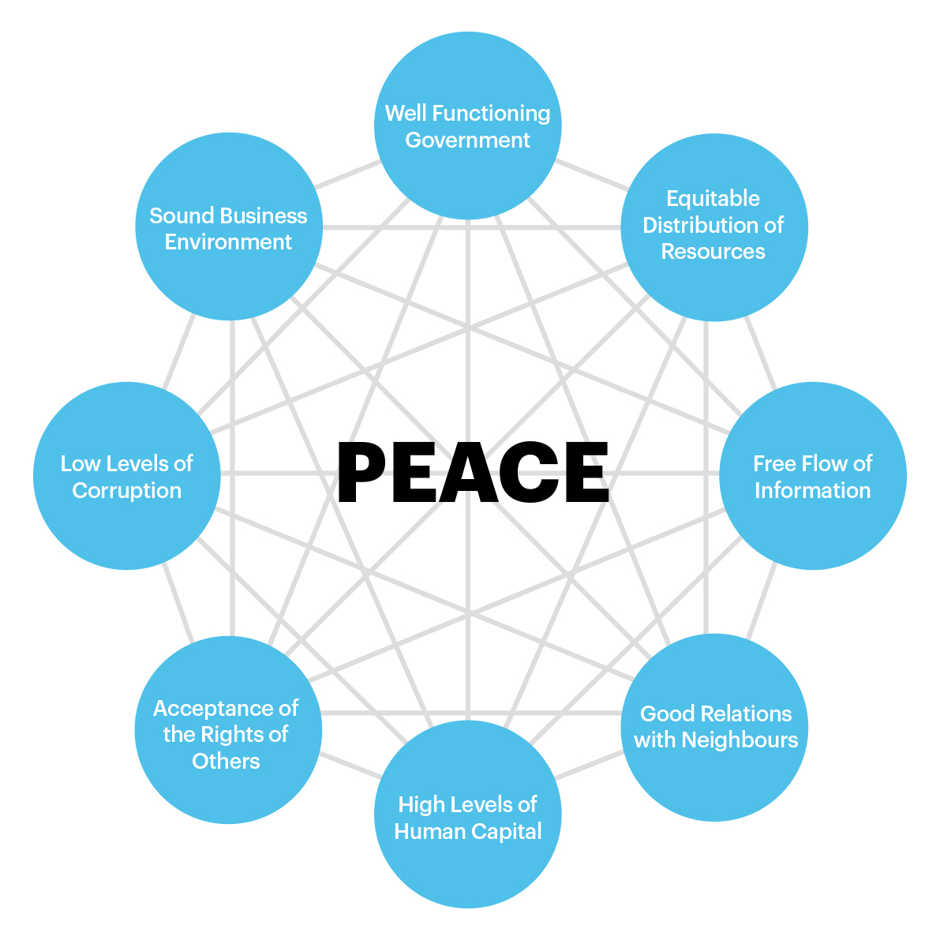
ACTIVITY: TWO SIDES TO THE COIN
Notes:
2 GROUPS: MINING COMPANY ABOUT TO ENTER COMMUNITY, LOCAL COMMUNITY
BRAINSTORM WHAT THIS MEANS CHALLENGES AND OPPORTUNITIES, FROM EACH PERSPECTIVE, ALONG PILLARS YOU THINK ARE RELEVANT

Slide 36
IEP’S POSITIVE PEACE WORKSHOPS

Slide 37
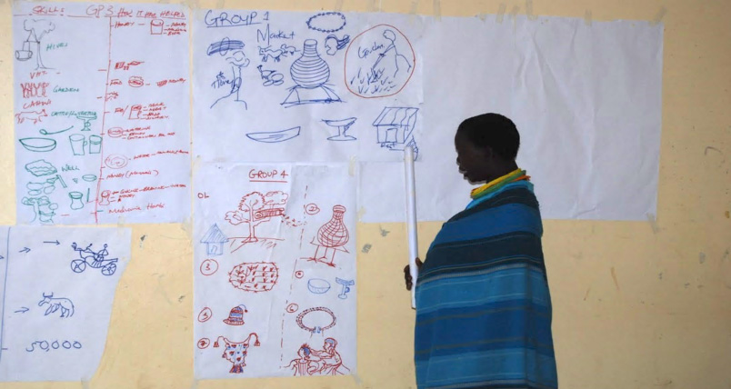
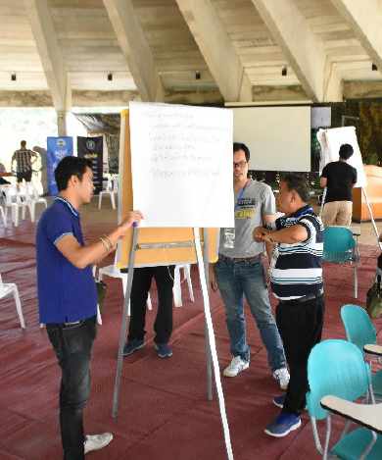
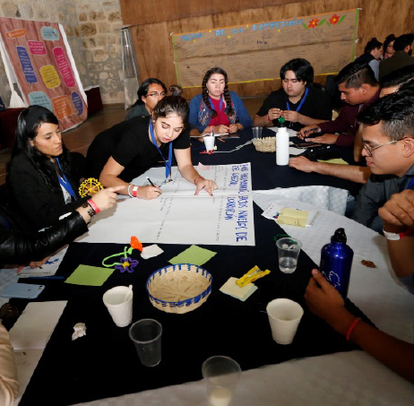
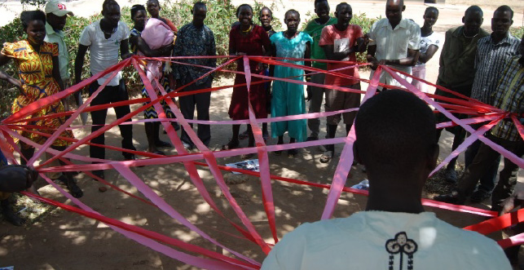
PP WORKSHOPS: RESEARCH DRIVEN, ON THE GROUND
GRASS ROOTS
Kenya, Uganda
POLICY MAKERS
Zimbabwe, Thailand
Emerging Leaders
Mexico, Libya/Tunisia 2017
Notes:
IEP ‘s Positive Peace Workshops are a modality to place our Positive Peace research into the hands of people. Through Positive Peace Workshops practitioners are introduced to Positive Peace research and build understanding of practical application of this research. Positive Peace Workshops are tailored for the context and language of the participants. They are adaptable to:
Strategic participants
Emerging leader groups
Community groups
We work with local partner organisations to produce agendas applicable to outcomes sought within the context of application
Positive Peace workshops are scalable. IEP, working with partner organisations, have delivered workshops from 40 to 400 participants. Workshops have been delivered in a variety of context, languages and countries including:
Uganda with Rotary
Tunis (for Libyan participants)
Mexico with Rotary
Thailand with Thailand Peace Network Foundation and United Nations Association of Australia
Zimbabwe with IPSI
The points of difference for IEP’s Positive Peace Workshops are:
They are based on the Positive Peace Framework which is empirically derived from IEP’s research into the system that leads to peaceful communities/countries
The workshops are relevant both at a national level and also at the community level.
It is a self-determination model where participants build their own understanding of their communities or countries improvement opportunities
The workshops are strengths based, building on community strengths as opposed to focusing of deficits
The workshops are fun, engaging and the learning experiential
The workshops are delivered by local facilitators who have the language and context knowledge

Slide 38
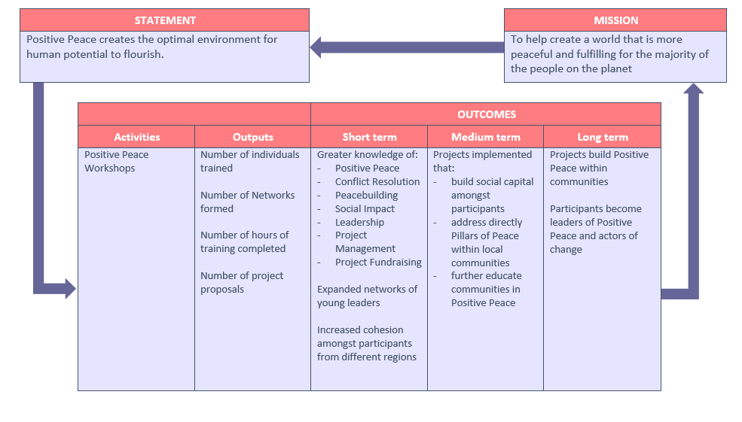
PP WORKSHOPS: THEORY OF CHANGE

Slide 39
PP WORKSHOPS: IMPACT
M & E SYSTEM IN PLACE TO CAPTURE CHANGES IN KNOWLEDGE, SKILLS, ATTITUDES AND BEHAVIOUR
EXAMPLE CHANGE IN ATTITUDES AROUND MINING
  MOROTO, UGANDA
EXAMPLE CHANGE IN BEHAVIOUR
  JUDE’S STORY

Slide 40
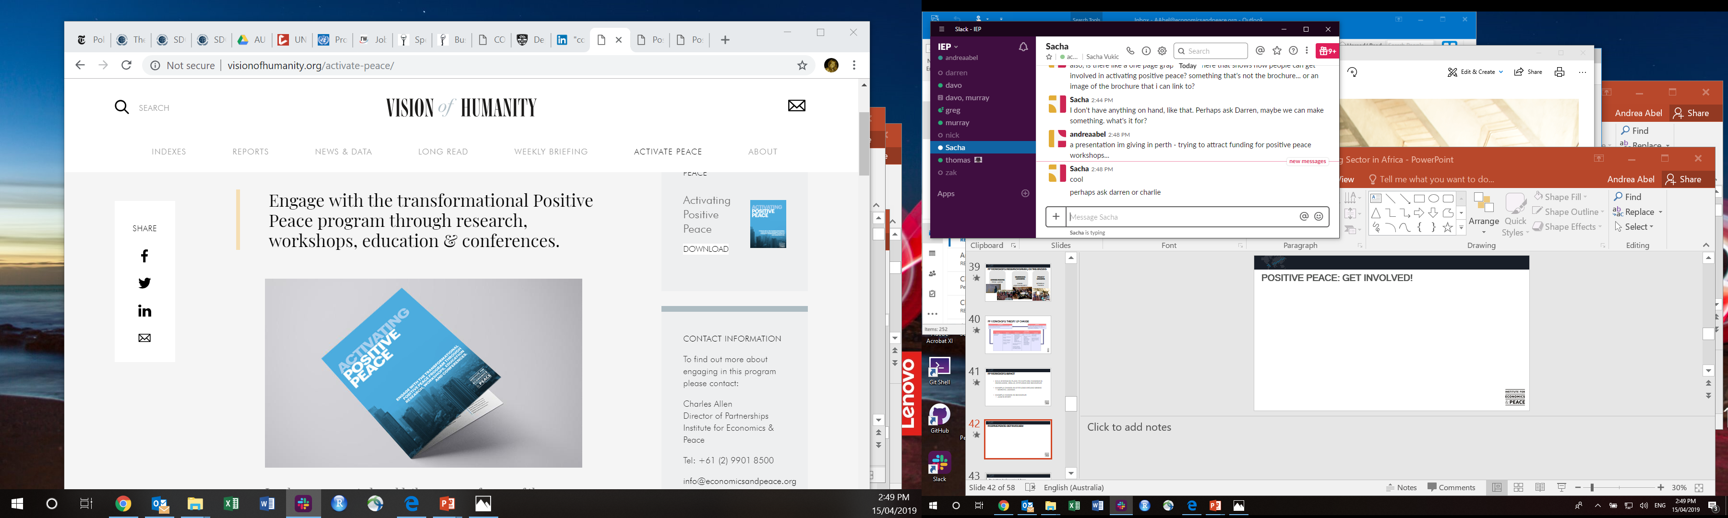
POSITIVE PEACE: GET INVOLVED!

Slide 41


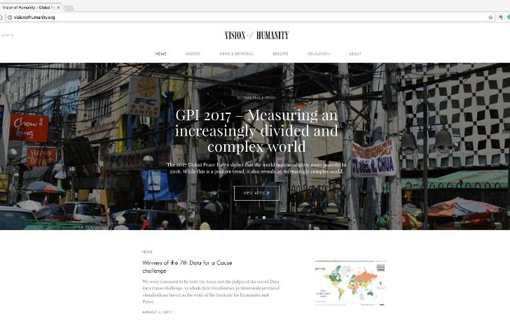

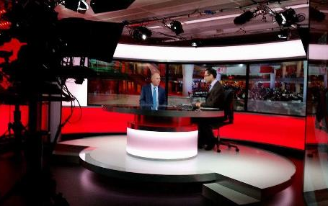
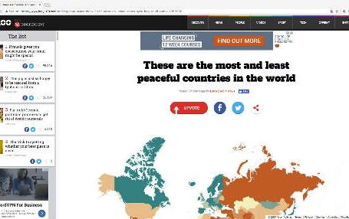
Connect with us
visionofhumanity.org
@GlobPeaceIndex
Explore peace indexes, peace research
and peace news and articles.
Keep up to date with the latest peace news.
GlobalPeaceIndex
@GlobalPeaceIndex
Like us on Facebook for articles, video and other peace related content.
Get the latest news and stories on Instagram.
Notes:
Institute for Economics and peace is dedicated to understanding the intersection between peace, prosperity and the economy.
We particularly seek to strip peace of its utopian connotations through developing methodologies and tools which move peace from a utopian ideal to a measurable goal.

