Slide 1
Modern Slavery Act 2018

Slide 2
Why is there a Modern Slavery Act?
Aim: combat modern slavery in the supply chains of Australian goods and services.
Up to 25 million modern slavery victims exploited in global supply chains.
Estimated 1,900 Australian victims.

Slide 3
What is modern slavery?
MODERN SLAVERY
Worker cannot refuse or cease work because of coercion, threats or deception.
Worker may also be deprived of personal freedom.
DANGEROUS OR SUBSTANDARD WORKING CONDITIONS
Worker can refuse or cease work but doing so may lead to detriment.
Worker is not paid fairly and does not receive some or all entitlements.
Worker may be required to work excessive hours.
Workplace is unsafe.
DECENT WORK
Workers’ rights respected.
Worker free to refuse or cease work.
Worker paid fairly (at least the minimum wage).
Workplace is safe.

Slide 4
What will the Modern Slavery Act do?
Reduce modern slavery risks in Australian goods and services.
Increase business awareness.
Drive business ‘race to the top’ to improve workplace practices.
Increase information for consumers, investors and business partners.

Slide 5
How was the Modern Slavery Act developed?
16 consultation roundtables. Discussion paper.
99 written submissions. 100+ meetings.
Three Parliamentary inquiries.
Lessons learned from overseas.

Slide 6
What does the Modern Slavery Act mean for you?
Covers over 3,000 large entities.
Entities must prepare annual Modern Slavery Statements.
Mandatory criteria for content.
Published on official online register.

Slide 7
What needs to be in a Modern Slavery statement?
Identify reporting entity/ies.
Describe structure, operations and supply chains.
Describe risks of modern slavery in global operations and supply chains
Describe actions to address risks
Describe how effectiveness assessed
Consultation with subsidiaries
Any other relevant information

Slide 8
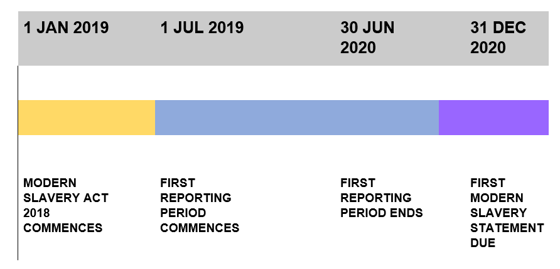
When do you need to comply?

Slide 9
Key messages
Understand the ‘business case’ for compliance.
Take a risk-based approach.
Demonstrate improvement over time.
Recognise you may find slavery.
Collaborate.

Slide 10
Modern Slavery Business Engagement Unit
Established to implement the Act.
Advise and support business.
Promote best-practice and monitor compliance.
Administer statements register.
Develop Commonwealth statement.
Email: slavery.consultations@home affairs.gov.au

Slide 11
Government guidance
Detailed A-Z guide to compliance.
Developed with business and civil society experts.
Modern Slavery Conference – 26-27 June

