Slide 1
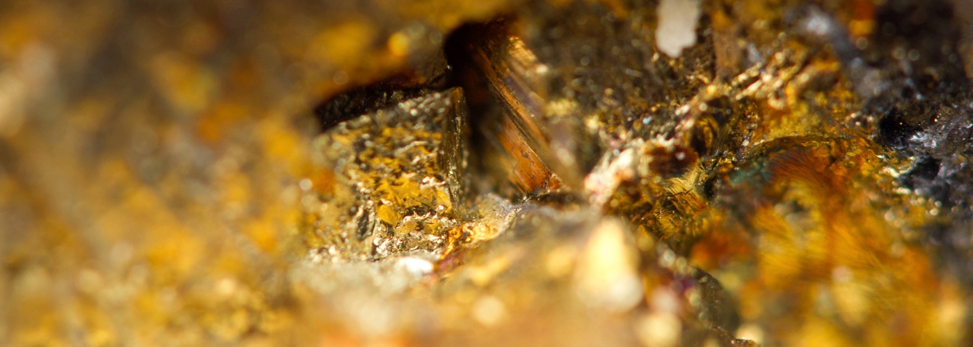
Creating Shared Value Through Effective Community Engagement
AAMEG, Thursday, 5 May 2016
Ken Ramsey, Group Executive Sustainability & External Relations, Newmont Asia Pacific

Slide 2
Cautionary statement
Cautionary statement regarding forward looking statements, including outlook:
This presentation contains “forward-looking statements” within the meaning of Section 27A of the Securities Act of 1933, as amended, and Section 21E of the Securities Exchange Act of 1934, as amended, and are intended to be covered by the safe harbor provided for under such sections. Such forward-looking statements may include, without limitation: (i) estimates of future production and sales; (ii) estimates of future All-in sustaining costs; (iii) estimates of future capital expenditures; (iv) our efforts to continue delivering reduced costs and efficiency; and (v) expectations regarding the development, growth and future potential at Tanami. Estimates or expectations of future events or results are based upon certain assumptions, which may prove to be incorrect. Such assumptions, include, but are not limited to: (i) there being no significant change to current geotechnical, metallurgical, hydrological and other physical conditions; (ii) permitting, development, operations and expansion of the Company’s operations and projects being consistent with current expectations and mine plans; (iii) political developments in any jurisdiction in which the Company operates being consistent with its current expectations; (iv) certain exchange rate assumptions for the Australian dollar to the U.S. dollar, as well as other the exchange rates being approximately consistent with current levels; (v) certain price assumptions for gold, copper and oil; (vi) prices for key supplies being approximately consistent with current levels; (vii) the accuracy of our current mineral reserve and mineralized material estimates; and (viii) other assumptions noted herein. Where the Company expresses an expectation or belief as to future events or results, such expectation or belief is expressed in good faith and believed to have a reasonable basis. However, such statements are subject to risks, uncertainties and other factors, which could cause actual results to differ materially from future results expressed, projected or implied by the “forward-looking statements”. Such risks include, but are not limited to, gold and other metals price volatility, currency fluctuations, increased production costs and variances in ore grade or recovery rates from those assumed in mining plans, political and operational risks, community relations, conflict resolution and outcome of projects or oppositions and governmental regulation and judicial outcomes. For a more detailed discussion of such risks and other factors, see the Company’s 2015 Annual Report on Form 10-K, filed on February 17, 2016, with the Securities and Exchange Commission (the “SEC”). The Company does not undertake any obligation to release publicly revisions to any “forward-looking statement,” including, without limitation, outlook, to reflect events or circumstances after the date of this presentation, or to reflect the occurrence of unanticipated events, except as may be required under applicable securities laws. Investors should not assume that any lack of update to a previously issued “forward-looking statement” constitutes a reaffirmation of that statement. Continued reliance on “forward-looking statements” is at investors' own risk.
U.S. investors are reminded that reserves were prepared in compliance with Industry Guide 7 published by the SEC. Whereas, the term resource, measured resource, indicated resources‖ and inferred resources‖ are not SEC recognized terms. Newmont has determined that such resources would be substantively the same as those prepared using the Guidelines established by the Society of Mining, Metallurgy and Exploration and defined as Mineral Resource. Estimates of resources are subject to further exploration and development, are subject to additional risks, and no assurance can be given that they will eventually convert to future reserves. Inferred resources, in particular, have a great amount of uncertainty as to their existence and their economic and legal feasibility. Investors are cautioned not to assume that any part or all of the inferred resource exists, or is economically or legally mineable. Estimates of resources are subject to further exploration and development, are subject to additional risks, and no assurance can be given that they will eventually convert to future reserves. Inventory and potential upside referenced in certain graphics used herein have a greater amount of uncertainty. Investors are reminded that even if significant mineralization is discovered and converted to reserves, during the time necessary to ultimately move such mineralization to production the economic and legal feasibility of production may change. As such, investors are cautioned against relying upon those estimates. For more information regarding the Company’s reserves, see the Company’s Annual Report filed with the SEC on February 17, 2016 for the Proven and Probable Reserve tables prepared in compliance with the SEC’s Industry Guide 7, which is available at www.sec.gov or on the Company’s website. Investors are further reminded that the reserve and resource estimates used in this presentation are estimates as of December 31, 2015.

Slide 3
Acknowledgement of Country
We respectfully wish to acknowledge the past and present elders and traditional owners of the land on which we are meeting on today, the Whadjuk (Perth region) people.

Slide 4
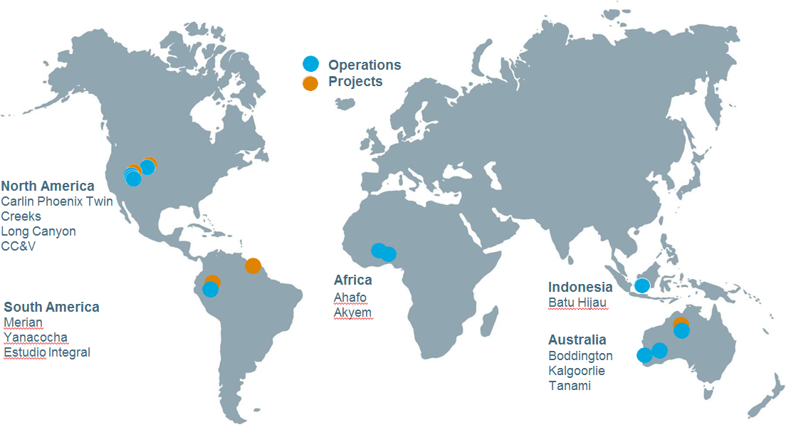
Newmont Global Operations

Slide 5
Setting the context
Our Purpose
Our purpose is to create value and improve lives through sustainable and responsible mining
Our Mission
We transform mineral resources into shared value for our stakeholders and lead the industry in shareholder returns, safety, social responsibility and environmental stewardship
Our Vision
We will be recognized and respected for exceptional economic, environmental and social performance
Our Values
Safety - We take care of our safety, health and wellness by recognizing, assessing and managing risk, and choosing safer behaviors at work and home to reach our goal of zero harm
Integrity - We behave ethically and respect each other and the customs, cultures and laws wherever we operate
Sustainability – We serve as a catalyst for local economic development through transparent and respectful stakeholder engagement and as responsible stewards of the environment.
Responsibility – We deliver on out commitments, demonstrate leadership, and have courage to speak up and challenge the status quo.
Inclusion - We create an inclusive environment where employees have the opportunity to contribute, develop and work together to deliver our strategy

Slide 6
Setting the context for Shared Value
Target
area
Government
Consistent with development priorities of local government
Company
Support business objectives and drivers
Arrived at through participatory processes

Slide 7
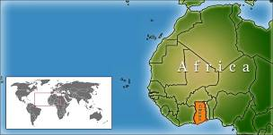
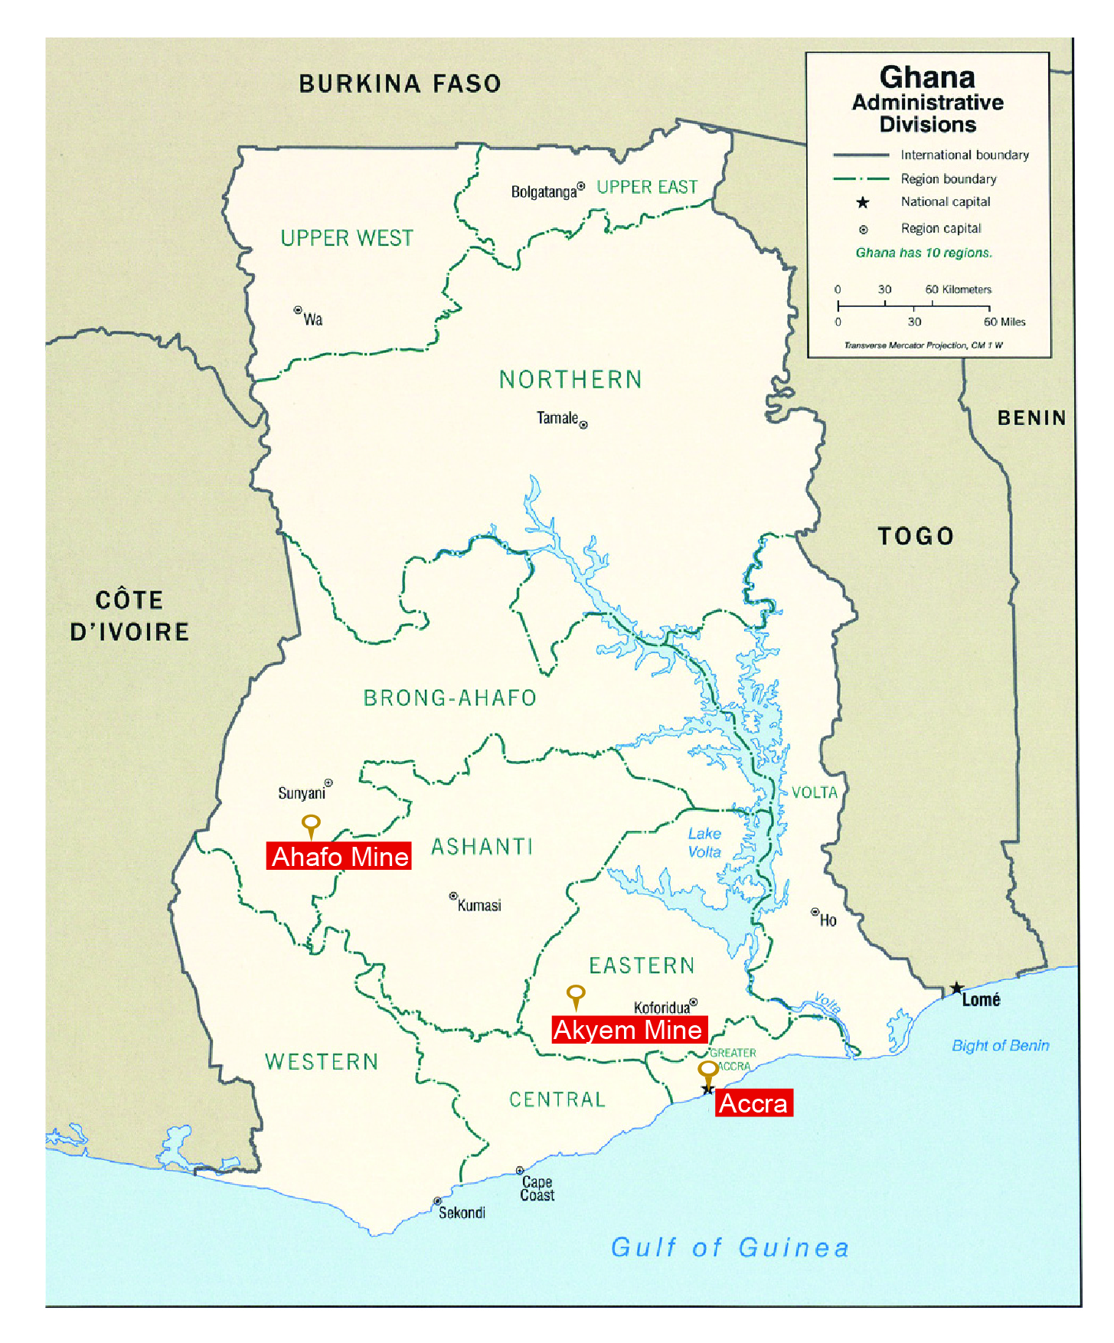
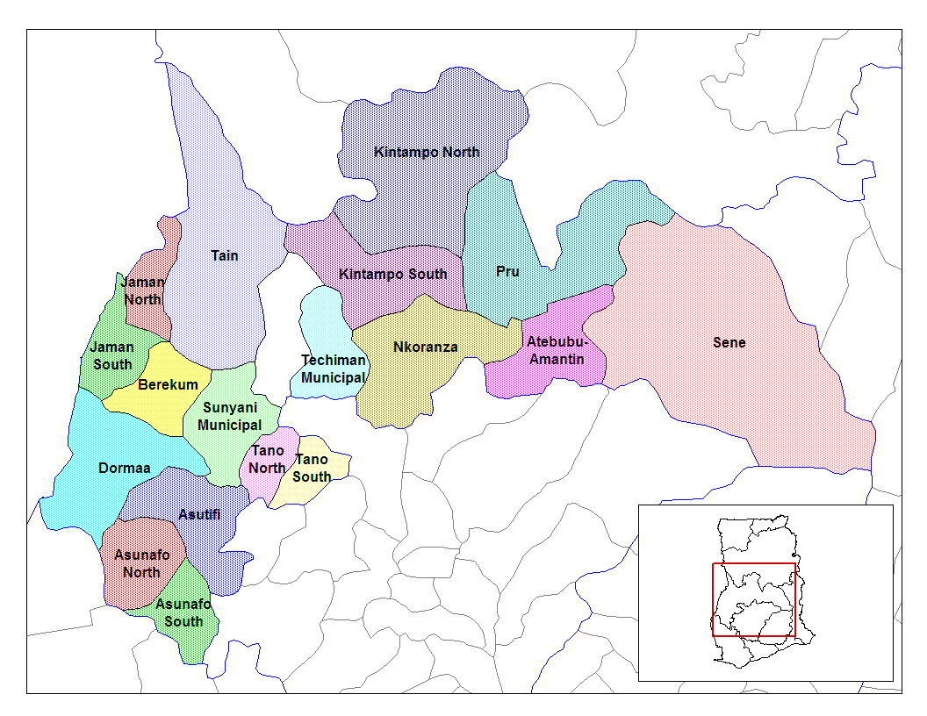
Newmont Ghana demonstrating shared value
Asutifi North:
Gyedu Kenyasi No. 1 Kenyasi No. 2 Ntotroso Wamahinso
Tano North:
Adrobaa Afrisipakrom Susuanso Terchire Yamfo

Slide 8
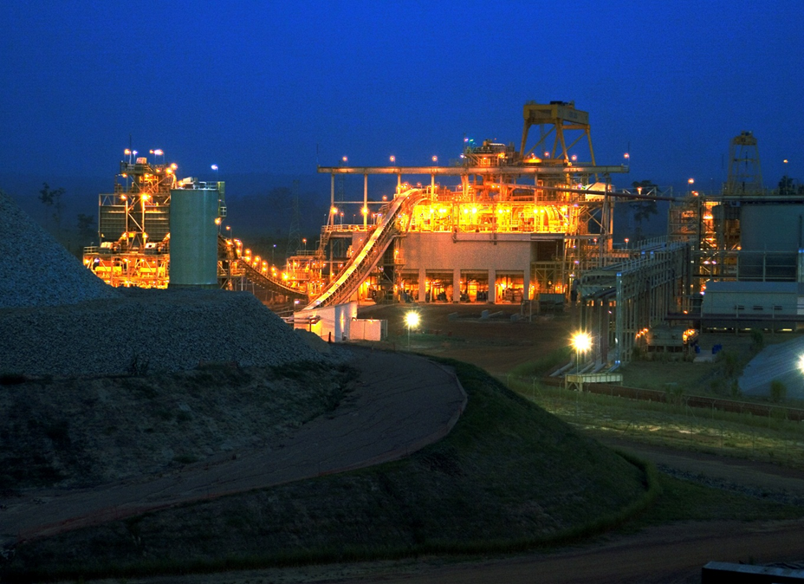
Newmont Ghana – Ahafo operation
Production commenced in 2006
332,000 ozs per annum (Dec 2015)
Bread Basket of Ghana – strong agricultural base
Traditional authorities strong part of social infrastructure
Resettlement and loss of farmlands – approx. 10,000 people impacted
IFC loan

Slide 9
Newmont Ahafo – setting the context
Ahafo South, ESIA, August 2005

Slide 10
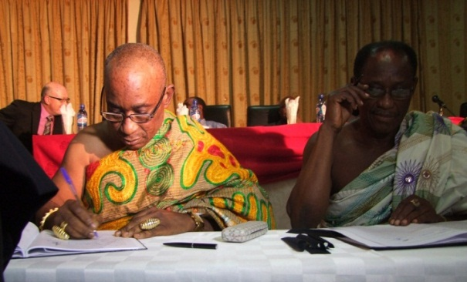
Newmont Ahafo Development Foundation (NADeF)
2005, $1 per ounce of gold and 1% of annual net profit towards sustainable community development
2006 Ahafo Social Responsibility Forum established
10 communities, 54 stakeholders
Representatives from different groups, e.g. traditional authorities, farmers, women's group, youth etc.
2008 NADeF Agreement signed
Similar agreement inaugurated in 2014 for Akyem, NAkDeF

Slide 11
Principles
Community Participation, Ownership & Sustainability
Strong Community representation
Independent Governance structure
Sustainability of Funding
Endowment Fund
Use of community resources
Projects alignment
Sustainable Development Committees (SDCs)
Joint ownership
Partnership opportunities

Slide 12
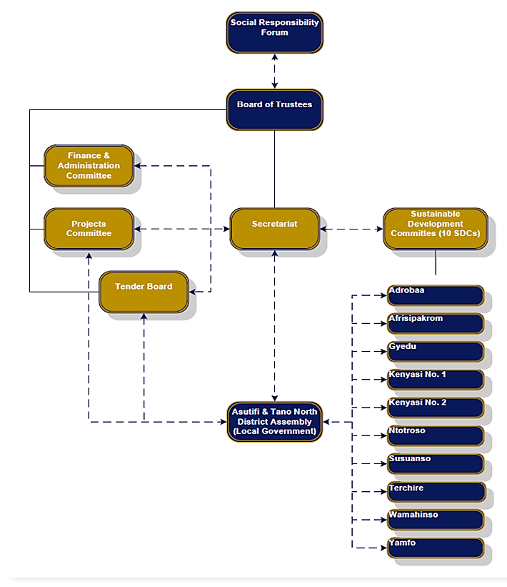
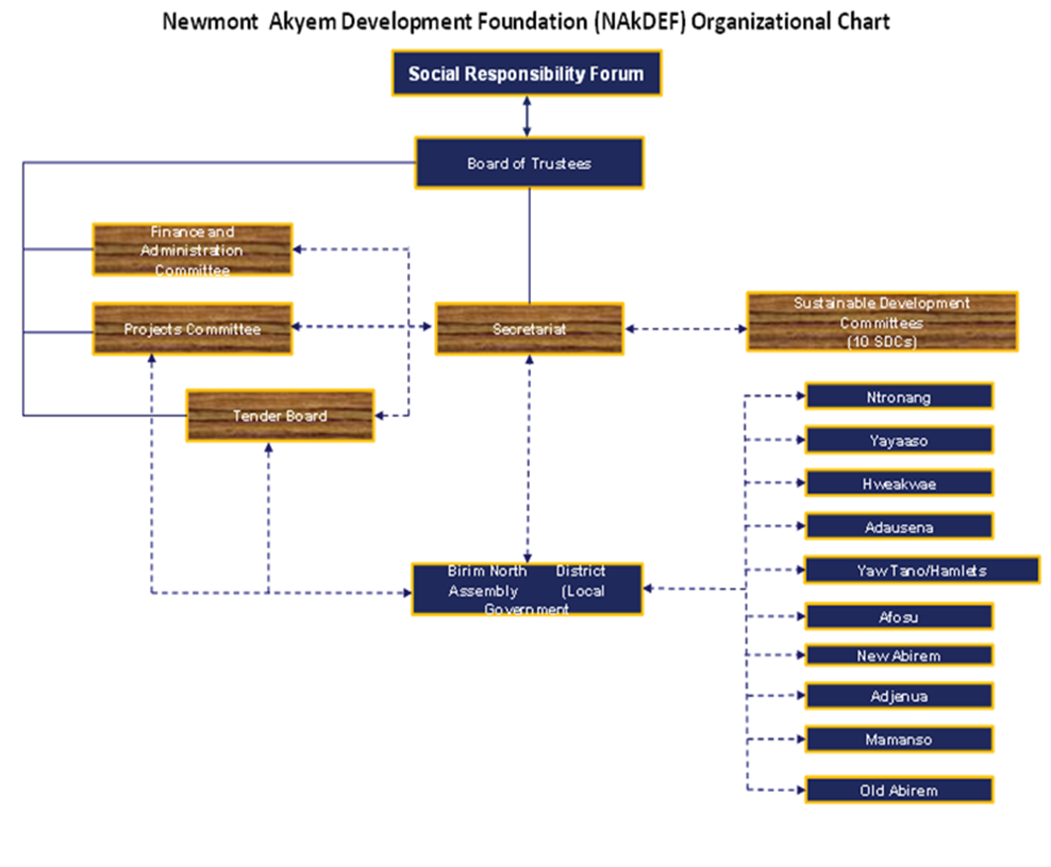
Organisational set up

Slide 13
Partnership and collaboration model
Party A
Monitoring
Deliberations & Consultations
Conflict Resolution
Agreement
Implementation
Party B
Stage 1
Stage 2
Stage 3
Stage 4

Slide 14
Application of the model at the Ahafo Mine

Slide 15
Our Development Foundations

Slide 16
Financial fact sheet
Supporting sustainable development and adding value to the communities in which we operate
Endowment fund – 10/15/20/25%
NADeF
NAkDeF
Allotment | Amount (approx.)
Fund Contributions | NADeF US$ 24M
Spent & Committed Funds | US$12M on projects US$ 1.5M on capital + operational costs
Endowment Fund | Over US$ 3.5 M
Allotment | Amount (approx.)
Fund Contributions | NAkDeF US$3.9
Spent & Committed Funds | US$ 60000 on NAkDeF secretariat

Slide 17
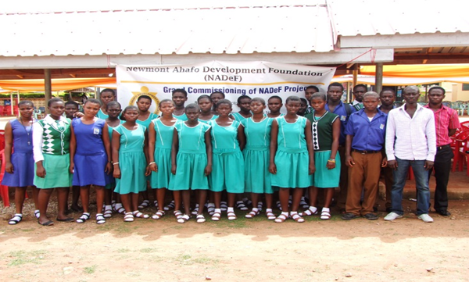
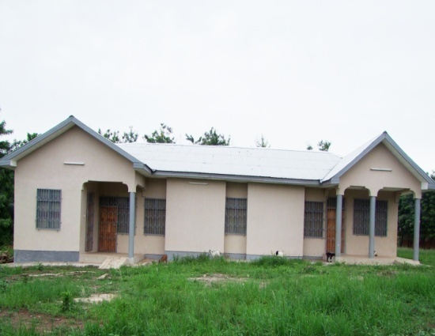
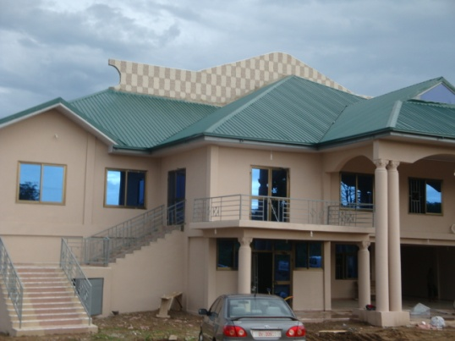
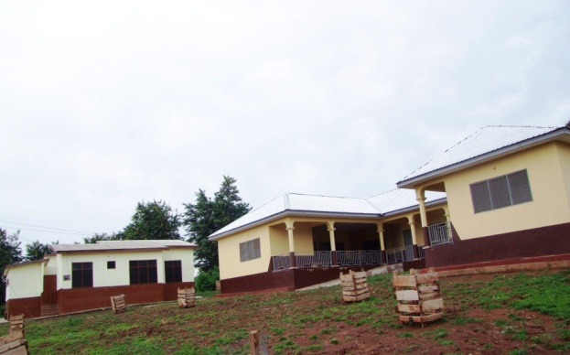
Projects in Pictures
Scholarships Beneficiaires
Community Center- Kenyasi No.1
Community Library - Afrisipakrom
Health Center/Nurses Quarters - Terchire
Ntotroso Nurses College classroom block

Slide 18
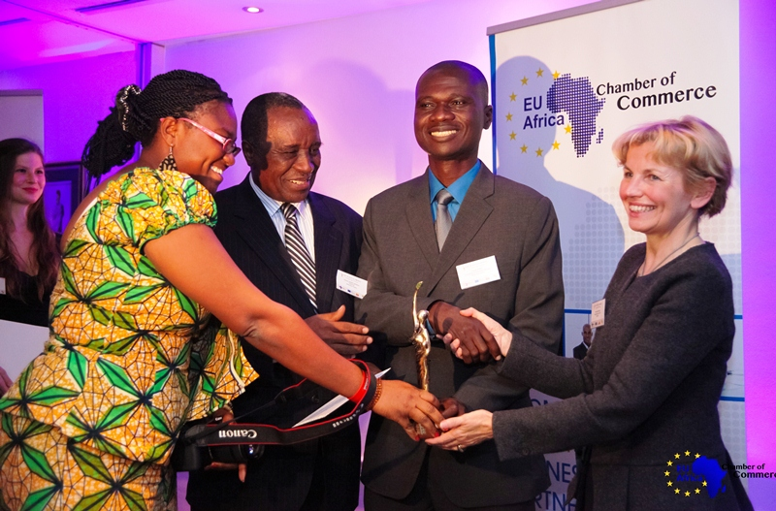
Our Success Story - NADeF
US$150,000 put into micro-credit scheme for local small-scale businesses
US$ 6.5 million put into 75 infrastructure and social amenities projects
6,000 beneficiaries awarded scholarships to a tune of US$ 3.5 million
Strong community and stakeholder participation
Adjudged the Best Social Impact Project in Africa by the European Union-Africa Chamber of Commerce
www.nadef.org
2014 EUACC Social Impact Project Award
ICT centres for basic schools

Slide 19
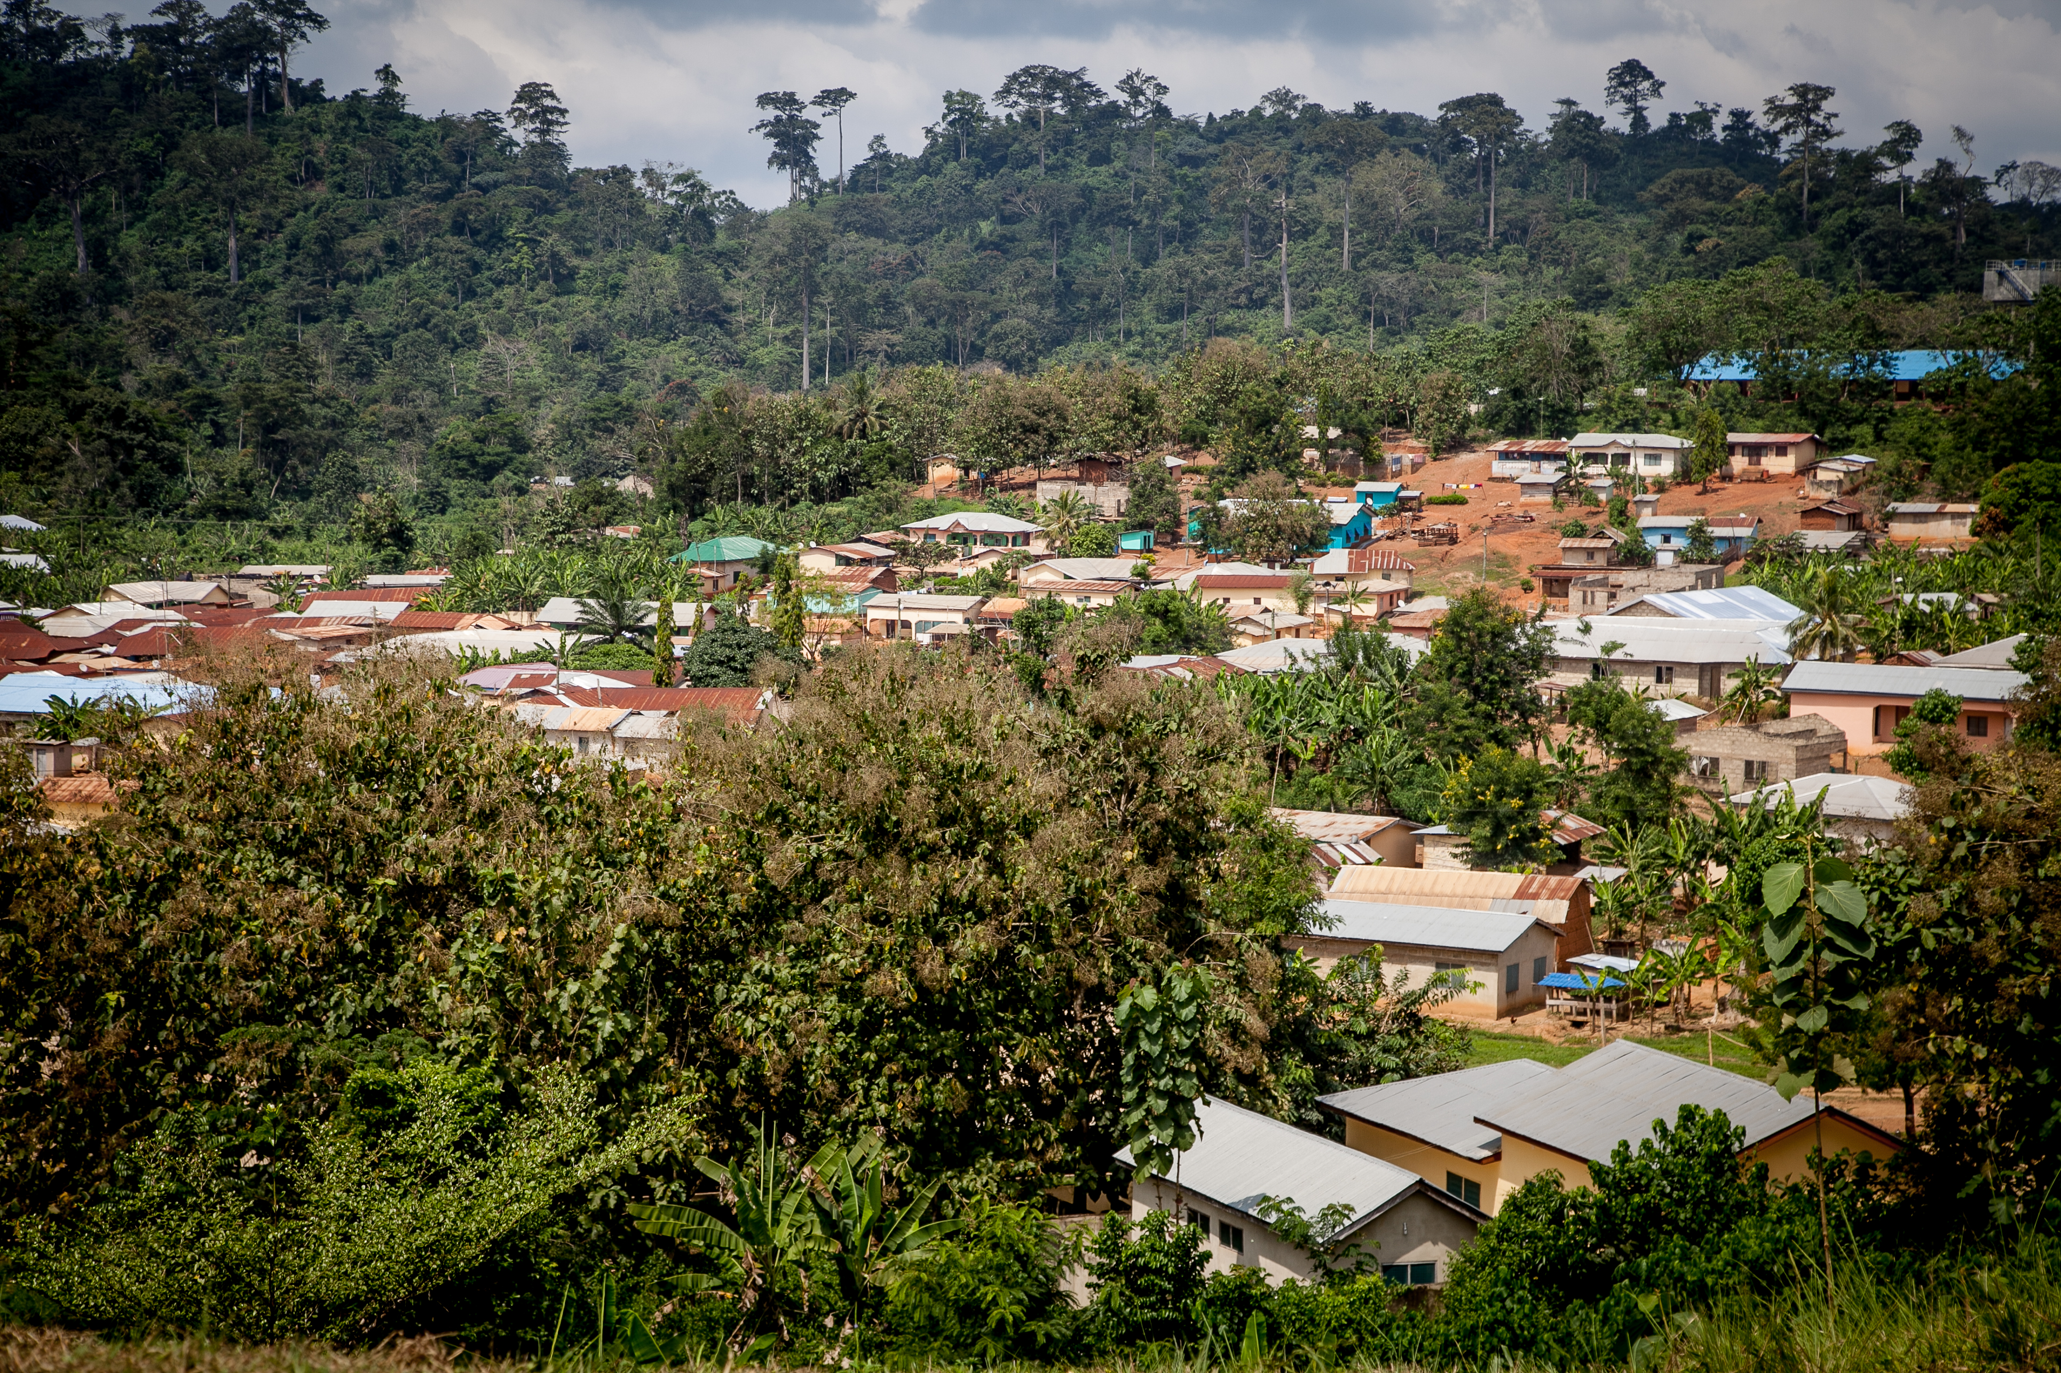
Challenges
Governance
Joint funding by communities
Local Government capacity to fully support operations and management of completed projects

Slide 20
Forging Ahead
Grant-making
Strategic partnerships
Training and capacity building
Long term planning by communities

Slide 21
Conclusion – revisit the Principles
Community Participation, Ownership & Sustainability
Sustainable Development Committees (SDCs)
Strong Community representation
Independent Governance structure
Sustainability of Funding
Endowment Fund
Use of community resources
Projects alignment
Joint ownership
Partnership opportunities
+ TIME

Slide 22
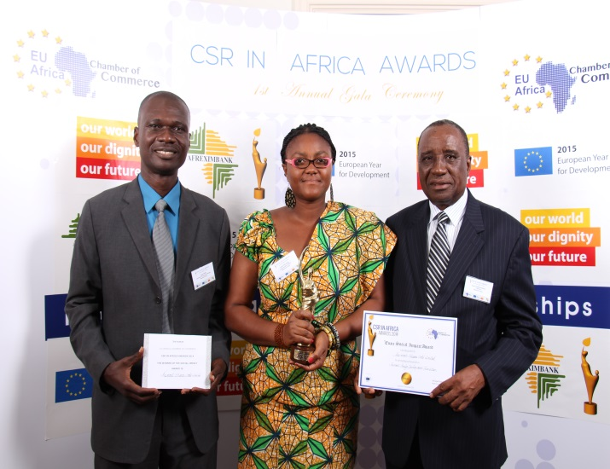
Conclusion
“NADeF ensures not only community ownership of the programs and projects from the Foundation, but also supports the principle of shared value which involves creation of economic value in a way that also create value for society by addressing its needs and challenges, even long after the mine closure”.

Slide 23
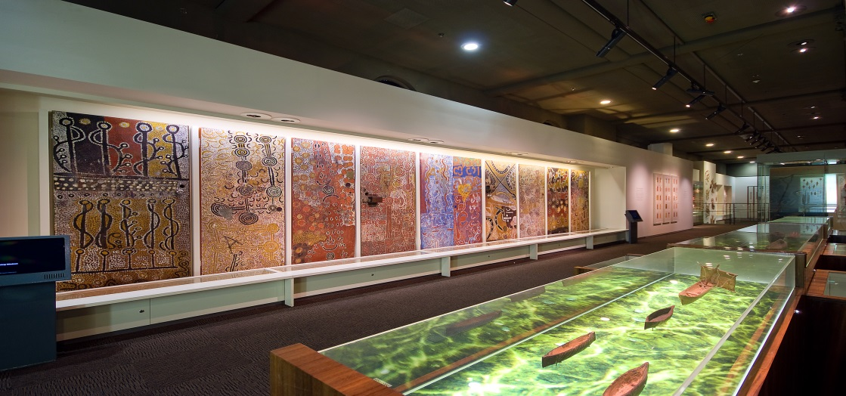
APAC Social Investment Programs
Notes:
AIME provides a dynamic educational Program that gives Indigenous high school students the skills, opportunities, belief and confidence to finish school at the same rate as their peers. AIME has proven to dramatically improve the chances of Indigenous kids finishing school. AIME also connects students with post Year 12 opportunities, including further education and employment.
As part of the CPA commitment NBG entered into 3 year partnership with AIME commencing Jan 2014.

Slide 24
Questions

