Slide 1
ANTI-BRIBERY & CORRUPTION
27 January 2015
Disclaimer: This presentation is for the purposes of creating awareness only and should not be relied upon as professional or legal advice.

Slide 2
Recent Developments in Anti-Bribery & Corruption Enforcement
Global network
A global network of anti-bribery regimes is being developed with vigour and being enforced rigorously.
Extra-territorial reach
Companies need to be aware of various domestic regimes and risk of being captured by extra-territorial application of regimes in USA, Canada, UK and Australia.
“Mind the Gap”
Wide gap between established corporate procedures and emerging, increasingly tough legal requirements.

Slide 3
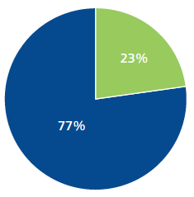
In Domestic Operations (Aust & NZ)
23% of organisations* in Deloitte 2015 Bribery & Corruption Survey experienced one or more instances of domestic corruption in last 5 years.
Most common types of domestic corruption:
Undisclosed conflict of interest,
Supplier kickbacks,
Personal favours, and
Inappropriate gifts/ hospitality.
Discovery of instances of domestic corruption:
Management review,
Internal controls, and
Tip-off from employees⁺.
* Increases to 47% for organisations with more than 5,000 employees.
⁺ Top discovery method for companies with more than 5,000 employees.
Source: Deloitte Bribery & Corruption Survey 2015

Slide 4
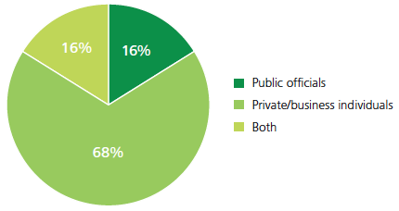
In Domestic Operations (Aust & NZ)
“Private sector to private sector” cases dominate:
84% of cases involved private/ business people, and
16% of cases involve only public officials.
Sectors with highest reported cases:
Energy/ Resources,
Government/ Public sector, and
Financial services.
Reporting of cases:
49% reported to law enforcement agencies,
24% reported to other stakeholders.
Source: Deloitte Bribery & Corruption Survey 2015

Slide 5
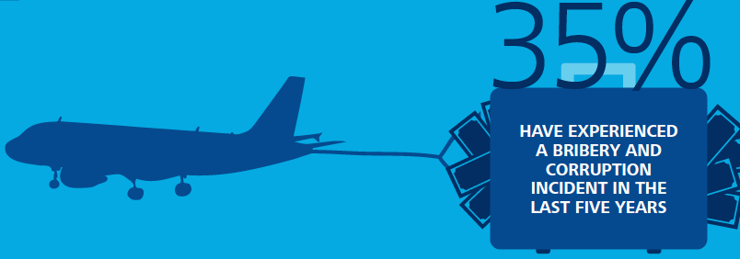
In high-risk Overseas Jurisdictions
35% experienced one or more instances of bribery & corruption in last 5 years.
Top industries to report offshore incidents:
Energy & Resources,
Manufacturing & Engineering,
Financial Services, and
Professional Services
Of the companies in high-risk overseas jurisdictions:
65% have not had a known incident in the last 5 years,
However,
46% have never conducted a corruption risk assessment,
19% do not discuss corruption risk at management or Board level.
Source: Deloitte Bribery & Corruption Survey 2015

Slide 6
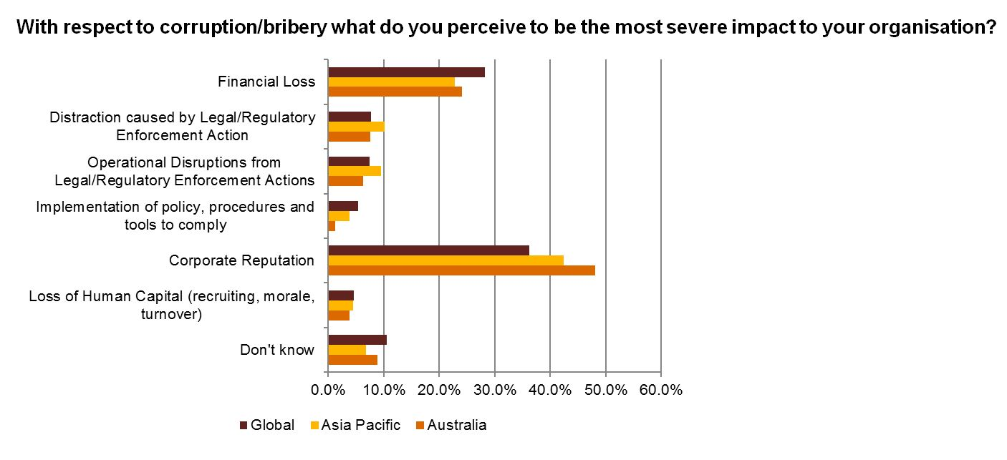
Impact of bribery & corruption
Source: PricewaterhouseCoopers Global Economic Crime Survey 2014

Slide 7
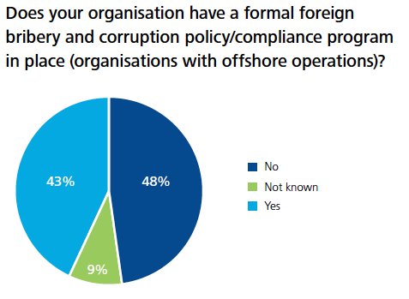
Deloitte Bribery & Corruption Survey 2012
2015 Survey: “No” + “Not known” = 40%
Source: Deloitte

Slide 8
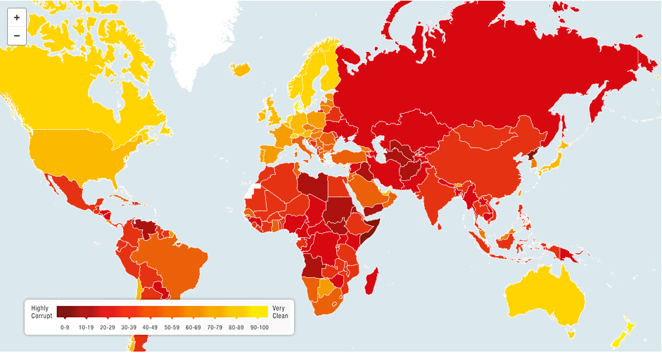
Transparency International Corruption Perception Index 2014
Country Rank Score
Denmark 1 92
New Z 2 91
Canada 10 81
Australia 11 80
UK 14 78
USA 17 74
S Africa 67 44
China 100 36
Indonesia 107 34
DRC 154 22
Nth Korea 174 8
Source: Transparency International

Slide 9
HISTORICAL CONTEXT
1977 Enactment of Foreign Corrupt Practices Act (“FCPA”) in USA
For two decades, USA was the only country to adopt extraterritorial anti-bribery laws
1997 OECD adoption of Convention on Combatting Bribery of Foreign Public Officials in International Business Transactions
1999 Australia becomes a party to OECD Convention (1997)
1999 Cwl Criminal Code Amendment (Bribery of Foreign Public Officials) Act
OECD Convention ratified by 34 member countries plus Argentina, Brazil, Bulgaria & South Africa
1999 Canadian Corruption of Foreign Public Officials Act (“CFPOA”)
2004 UN Convention Against Corruption developed
Australia ratifies UN Convention Against Corruption (which does not recognise Facilitation Payments)
2008 OECD Phase 2 Report critical of Australia, UK and Japan

Slide 10
HISTORICAL CONTEXT - 2
2010 Tightening of Aust. bribery defences and increase in penalties
2011 UK Bribery Act prohibits Facilitation Payments
2011 UN and OECD criticism of Australia and Japan re ineffective enforcement
2011 Public Comment Call: Assessing the “facilitation payments defence” to the Foreign Bribery offence and other measures
AAMIG Submission to Federal Attorney-General regarding facilitation payments defence and other measures
2012 OECD Phase 3 Report (Oct 2012) on Australia critical of AFP & ASIC enforcement measures and coordination efforts
2012 AFP establishes a Foreign Bribery Panel to advise AFP investigation teams & strengthen enforcement efforts
2012 Further tightening of Australian Bribery penalties (Dec 2012)
2013 Canada “books & records” & removal of “facilitation payments defence”

Slide 11
OBJECTIVES OF AAMEG ABC WORKSHOPS
Position AAMEG Members so that they are able to comply with key provisions of relevant Anti-Bribery and Corruption legislation by:
Developing an appropriate Corporate Culture through policy development and training, including adaptive learning.
Establishing appropriate and credible Systems and Processes and communicating procedures required to their employees.
Developing effective third-party, risk-based due diligence to control and minimise Contractor and Successor Liability.
Establishing effective internal Whistle-blower and investigation procedures.
Using an Ethical Corporate Culture to develop a competitive advantage; to attract funds & to attract and keep the best employees.
Appreciate the Value Creating & Value Protecting aspects of good governance.
Empower Directors and Officers deliver more fully on their “duty of care” responsibilities to employees.

Slide 12
AAMEG Guiding Documentation (around management of ABC risk)
United Nations Convention Against Corruption (2004)
Ratified by Australia in 2005
OECD Convention on Combatting Bribery of Foreign Public Officials in International Business Transactions (2011)
Supported by the authority of 39 member states
Guidance Note on Risk Analysis and Appropriate Measures for Compliance for Operating in Developing Countries (Jul 2015)
Developed by AAMEG & Clayton Utz
Extractive Industries Transparency Initiative (EITI)
Encouraging member companies to become EITI supporting & reporting companies

Slide 13
Legal Professional Privilege
Materials created for the dominant purpose of obtaining legal advice are protected from production by legal professional privilege.
Privilege applies only to confidential materials/ communications.
It is a critical protection that allows companies to:
Conduct investigations & obtain compliance advice with full and frank consideration of potentially sensitive information; and
Maintain control over disclosure of privileged information (including to resist production in litigation / regulatory investigations).

Slide 14
Recent Developments - Australia
Strengthening of Aust. Criminal Code (2010 & 2012)
Personal:
Criminal record for the individual,
Fines up to $1.7 million, and
Gaol terms up to 10 years.
Company:
Fines up to $17 mill,
Or 3x value of benefits obtained, or
10% of annual turnover, whichever the greater.
AFP investigating 14 cases as at beginning of 2015. (Deloitte Survey 2015)

Slide 15
AAMEG response to developments in Aust.
Submission to Government, Dec 2011
28 page document prepared with support of Clayton Utz
Appearance before OECD Panel in Sydney, May 2012
OECD Phase 3 Report, Oct 2012
AAMEG Anti-bribery & Corruption Workshops
in Perth, Melbourne, Sydney & Brisbane, 2012
Advocating on retention of Facilitation Payment Defence
in Canberra & with Transparency International
Presenting at EITI Global Conference
in Sydney, May 2013
Scenario Analysis Sessions (under The Chatham House Rule)
Additional Submission to Senate Committee in Aug 2015
Follow-up in Canberra in Nov 2015

Slide 16
Recent Developments - UK
UK Bribery Act (2010) became law on 1 July 2011,
Broad extra-territorial reach effect,
New strict liability offence for “failing to prevent bribery”, including in private sector,
No Facilitation Payment Defence, and
Offence applies to companies carrying on “any part of their business in the UK” with SFO indicating they will adopt an aggressive interpretation of this provision.

Slide 17
Recent Developments - Canada
Broad amendments to Canada’s CFPOA tabled in Senate on Feb 5, 2013 and given royal assent 18 June 2013.
Aimed at bringing Canada’s anti-corruption regime more closely into line with:
US FCPA by creating a “books and records” offence,
UK Bribery Act by eliminating Facilitation Payments Defence,
and
Broadening definition of “business” to include NGOs,
Establishing nationality jurisdiction (extra-territorial reach),
Increasing maximum sentence (gaol terms 5 to 14 yrs, fines unlimited).
Guilty pleas by Niko Resources (June 2011) and Griffiths Energy Internat.(Jan ‘13) and 35 investigations already underway.

Slide 18
US FCPA Enforcement Actions 2004-13
Source: Gibson & Dunn
Source: Gibson Dunn

Slide 19
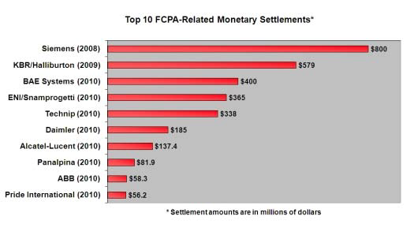
Top 10 FCPA-Related Monetary Settlements
Recent additions to Top 10:
Alstrom (Fr) $772m in 2014
Total SA (Fr) $398m in 2013
Alcoa (USA) $384m in 2014
JGC Corp (Jap) $218m in 2011
Source: Gibson Dunn & FCPA Blog

Slide 20
Policy Documents – only the first step
Having a policy document is not sufficient.
Ethical Corporate Culture: Need to be able to demonstrate the practical application of the policy provisions.
Staff from CEO to the “coal face” need to be able to convince an outsider they understand the Anti-Bribery & Corruption policy, are implementing the provisions of the policy, and in turn are contributing to building an ethical corporate culture.
Appropriate training must be undertaken, appropriately documented. Duly acknowledged by recipients and discussed and recorded at Board level.
Proportionate procedures with appropriate monitoring and review to ensure traction, compliance & value protection/ creation.

Slide 21
On-going Due Diligence
Undertake appropriate due diligence on new business partners, agents and tender processes,
Include reference to Company Policy documents,
Establish continuous monitoring and internal audit protocols,
Include “Right-to-audit” clauses over third parties,
Actively search for Red Flags,
Use data analytics technology to identify abnormal activity that may require more thorough investigation, and
Support Whistle-blowers with appropriate internet anonymity.

Slide 22
Corporate Liability
Corporate liability established when an offence committed by an employee, agent or officer of the company and the company “expressly, tacitly or impliedly” authorised or permitted the commission of an offence,
“Authorisation or Permission” by the company can be established by showing:
The board of directors or a high managerial agent intentionally, knowingly or recklessly carried out the conduct or expressly, tacitly or impliedly permitted the commission of an offence,
A corporate culture existed that directed, encouraged, tolerated or led to an offence, or
The company failed to create and maintain a corporate culture that required compliance with the relevant laws.
Not knowing is no defence, if in a position to know.

Slide 23
Director Liability
Anti-Bribery Laws expose directors to criminal and personal liability,
Criminal liability does not require direct involvement,
Failure to ensure company has a sufficiently strong corporate culture of compliance with anti-bribery & corruption legislation can suffice.
Following OECD criticism on lack of enforcement, AFP expected to work more aggressively and more closely with ASIC to pursue individuals and companies.
ASIC expectations of directors:
Must understand the business and how company is run,
Must apply an enquiring mind and be constructively sceptical,
Individual responsibilities not limited to field of expertise.
D&O insurance will not cover penalties for a foreign bribery offence.

Slide 24
Beyond Anti-Bribery Law
Directors may face ASIC prosecution & civil penalties under Corporations Law:
Civil penalties up to $200,000, or
Up to 5 year’s gaol in cases of recklessness or dishonesty.
Directors may face shareholder reaction:
“Board of directors failed to implement proper anti-corruption controls, exposing the company to significant criminal and civil liability by allowing company personnel to make improper payments to public officials.”
“Company’s share price dropped substantially as a result of bribery allegations being made.” (eg Leighton, Oct 2013)
Anti-bribery & corruption compliance needs to be a top-down-driven initiative.

Slide 25
Definition of what constitutes bribery
Providing or offering (or causing someone to provide or offer) a benefit to another person,
that is not legitimately due,
with the intention of influencing a public official or any other person in the exercise of their duties,
to obtain or retain business or a business advantage that is not legitimately due.
Inducing a public official to circumvent the law and deliver an illegal benefit.

Slide 26
Further Definitions - 1
Benefit
Not limited to money or property,
Need not be provided to public official directly,
Acting through an agent is no defence, and
Need not be actually paid – “offering” is an offence.
Legitimately due
No regard to custom, value or official tolerance, and
Local government codes of conduct etc may inform but do not define.

Slide 27
Further Definitions - 2
Gifts & Entertainment
For relationship building only,
Cannot be construed as an attempt to adversely influence a person in the performance of his/her role,
Complies with law and government policy,
Given in an open & transparent manner,
Does not include cash, loans or cash equivalents, and
Proper and accurate records are kept.

Slide 28
Wording in Contracts
Employees / Consultants / Contractors
The Company, through its Code of Conduct, demands and expects high standards of behaviour and conduct on the part of its employees when carrying out Company business or representing the Company.
The Company will not tolerate any attempt by its employees, contractors or consultants to illegitimately influence any public official in the exercise of his or her official duties.
The Executive/Consultant undertakes and agrees to comply at all times, whilst engaged by the Company, with the anti-bribery provisions in the Australian Criminal Code, the Canadian Corruption of Foreign Public Officials Act, the US FCPA and with any international laws relating to the corruption of foreign public officials.
Any breach of this policy on the part of the Consultant/ Contractor will result in the immediate termination of the Consultant/ Contractor’s contract and severance of any association with the Consultant/ Contractor’s partners, organisation or other representatives associated with the Consultant.

Slide 29
Defences
Lawful if written into law of country in which payment is made.
As a Facilitation Payment:
Minor unofficial payment to foreign public official,
to secure the timely delivery or execution of routine govt service,
to which you are legally entitled.
But not permitted under UK law (2011), [or Canadian law (18 June ‘13).]
Defences recently reviewed:
In Australia (Nov 2011), and
Currently again under review (since Aug 2015).

Slide 30
Parallel Situation in WA
WA Govt finds difficulty in keeping Mines Safety & Inspection personnel at existing pay levels,
Companies asked to make up salary difference - a special purpose levy,
Levy Regulation introduced on 24 April 2010,
Companies required to pay levy if total hours worked exceeds 5,000 hours per quarter,
Levy Rate for 2011/12 financial year was $0.18 per hour (expected to amount to $27 million),
Funds collected are held in a Special Purpose Account, and spent administering the Mines Safety and Inspection Act 1994 only.
Difference in WA: Single issue and it is legislated.
In Africa: Multiple and diverse issues + generally weak institutions.

Slide 31
OECD Report Card on Australia – Oct 2012
Overall enforcement “extremely low”:
28 foreign bribery referrals received by AFP since 2005,
21 without charge,
1 has led to prosecutions, and
7 remain ongoing (as at Oct 2012).
Investigation and enforcement stats do not match:
Size of Australian economy,
Its level of exports, and
Risk profile for Australian businesses given countries of operation.
Recommendations:
Raise awareness of distinction between facilitation payments and acts of bribery and corruption, and actively move to eliminate,
Increase sanctions and enforcement, and
Improve whistle-blower provisions.

Slide 32
Ethical Corporate Culture
Companies must develop an appropriate Corporate Culture supported by comprehensive policies and compliance programs, effective training, due diligence, risk mitigation procedures and appropriate review and monitoring – documented properly.
Such an approach creates value and protects value.
It also delivers on Duty of Care responsibilities to employees.

Slide 33
References
The Canadian CFPOA (1999) – A Guide
http://www.publications.gc.ca/collections/Collection/J2-161-1999E.pdf
United Nations Convention Against Corruption (2004)
https://www.unodc.org/documents/brussels/UN_Convention_Against_Corruption.pdf
OECD Convention on Combatting Bribery of Foreign Public Officials in International Business Transactions (2011)
http://www.oecd.org/daf/anti-bribery/ConvCombatBribery_ENG.pdf
The UK Bribery Act 2010 – Quick start guide (2011)
https://www.justice.gov.uk/downloads/legislation/bribery-act-2010-quick-start-guide.pdf
A Resource Guide to the US Foreign Corrupt Practices Act, (2012).
http://http://www.sec.gov/spotlight/fcpa/fcpa-resource-guide.pdf
Transparency International (2014)
http://www.transparency.org/cpi2014/results

Slide 34
References cont’d …
Australian Anti-Bribery & Corruption Compliance Obligations, Prepared by Clayton Utz for AAMIG, Jul 2015
http://aameg.org/wp-content/uploads/2015/07/Australian-ABC-Compliance-Obligations-Summary-for-AAMIG-July-2015.pdf
Foreign anti-bribery – an international report card on Australian law and enforcement, Clayton Utz Insights, Nov 2012
https://www.claytonutz.com/publications/edition/08_november_2012/20121108/foreign_anti-bribery-an_international_report_card_on_australian_law_and_enforcement.page
Doing Business in Australia: Anti-bribery, Clayton Utz Insights, Nov 2014
http://www.claytonutz.com/publications/edition/27_november_2014/20141127/doing_business_in_australia_anti-bribery.page
Source acknowledgements: Clayton Utz, Deloitte, PricewaterhouseCoopers, McCarthy Tetrault, MinterEllison, Allens><Linklaters, Veracity Worldwide, Gibson Dunn, McGrathNicol, Transparency International.

Slide 35
Bill Turner – Chairman
Mobile: 0411 188 018
bill.turner@aameg.org
Trish O’Reilly – CEO
Mobile: 0401 843 513
trish.oreilly@aameg.org
Suite 9, 1297 Hay St, West Perth 6005
For more information please visit our website
PO Box 1018, West Perth 6872
www.aameg.org
Telephone: +61 (08) 9226 0175
Email: info@aameg.org

Slide 36
Workshop supporting member companies:
Disclaimer: This presentation is for the purposes of creating awareness only and should not be relied upon as professional or legal advice.

